Slide 1

Hadoop Lecture
Sunrise Technologies

Slide 2
Key Questions to Answer
Why Hadoop?
What is Hadoop?
How to Hadoop?
Examples of Hadoop

Slide 3
Why is Hadoop ?

Slide 4
What is Big Data
A bunch of data?
A technical term?
An industry?
A trend?
A set of skills?
…
What is your interpretation of BIG DATA?

Slide 5
What is Big Data
Wikipedia big data
An all-encompassing term for any collection of data sets so large and complex that it becomes difficult to process using on-hand data management tools or traditional data processing applications.

Slide 6
How big is big?
2008: Google processes 20 PB a day
2009: Facebook has 2.5 PB user data + 15 TB /day
2011: Yahoo! has 180-200 PB of data
2012: Facebook ingests 500 TB/day
2013: YouTube 1000 PB video storage; 4 billion views/day
1 PB=10^3 TB=10^6 GB=10^15 B
1 Exabyte = 1000 PB
Zettabyte, Yottabyte …
Notes:
alphabets

Slide 7
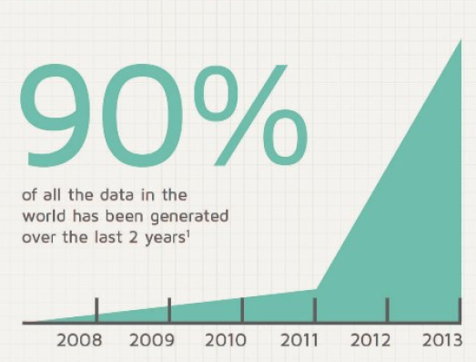
The percentage of all data in the word that has been generated in last 2 years?

Slide 8
Who is generating Big Data?

Slide 9


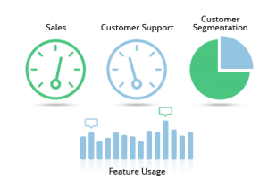








Who is generating Big Data?
Social
User Tracking & Engagement
Homeland Security
eCommerce
Financial Services
Real Time Search

Slide 10

That is a lot of data …

Slide 11
What are Key Features of Big Data?
Volume
Velocity
Petabyte scale
Social Media
Sensor
Throughput
Big Data
Variety
4 Vs
Veracity
Structured
Semi-structured
Unstructured
Unclean
Imprecise
Unclear

Slide 12
Philosophy to Scale for Big Data?

Slide 13
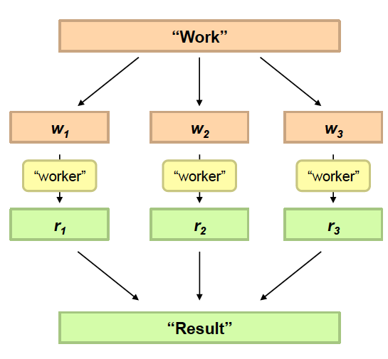
Divide and Conquer
Divide Work
Combine Results

Slide 14

Distributed processing is non-trivial
How to assign tasks to different workers in an efficient way?
What happens if tasks fail?
How do workers exchange results?
How to synchronize distributed tasks allocated to different workers?

Slide 15
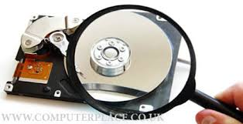
Big data storage is challenging
Data Volumes are massive
Reliability of Storing PBs of data is challenging
All kinds of failures: Disk/Hardware/Network Failures
Probability of failures simply increase with the number of machines …

Slide 16
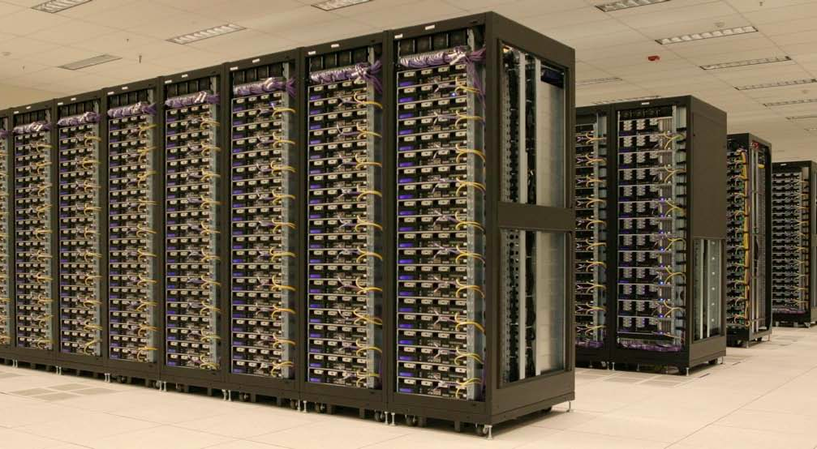
One popular solution: Hadoop
Hadoop Cluster at Yahoo! (Credit: Yahoo)

Slide 17

Hadoop offers
Redundant, Fault-tolerant data storage
Parallel computation framework
Job coordination

Slide 18


Hadoop offers
Redundant, Fault-tolerant data storage
Parallel computation framework
Job coordination
Q: Where file is located?
No longer need to worry about
Q: How to handle failures & data lost?
Q: How to divide computation?
Programmers
Q: How to program for scaling?

Slide 19



A real world example of New York Times
Goal: Make entire archive of articles available online: 11 million, from 1851
Task: Translate 4 TB TIFF images to PDF files
Solution: Used Amazon Elastic Compute Cloud (EC2) and Simple Storage System (S3)
Time: ?
Costs: ?
Notes:
New York Times Faced Challenge in 2007:
Challenging and Complicated Computing Chore
http://www.greenm3.com/gdcblog/2008/11/5/nytimes-aws-cloud-computing-mistake-cost-240.html

Slide 20
A real world example of New York Times
Goal: Make entire archive of articles available online: 11 million, from 1851
Task: Translate 4 TB TIFF images to PDF files
Solution: Used Amazon Elastic Compute Cloud (EC2) and Simple Storage System (S3)
Time: < 24 hours
Costs: $240
Notes:
New York Times Faced Challenge in 2007:
Challenging and Complicated Computing Chore
http://www.greenm3.com/gdcblog/2008/11/5/nytimes-aws-cloud-computing-mistake-cost-240.html

Slide 21

So we are

Slide 22

A little history on Hadoop
Hadoop is an open-source implementation based on Google File System (GFS) and MapReduce from Google
Hadoop was created by Doug Cutting and Mike Cafarella in 2005
Hadoop was donated to Apache in 2006

Slide 23
Who are using Hadoop?
Social
User Tracking & Engagement
Homeland Security
“By 2015, 50% of Enterprise data will be processed by Hadoop” –Yahoo!
eCommerce
Financial Services
Real Time Search

Slide 24
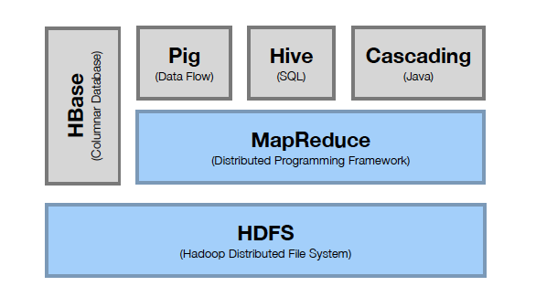
Hadoop Stack
Computation
Storage

Slide 25
HDFS Hadoop Distributed File System

Slide 26
HDFS Outline
Motivation
Architecture and Concepts
Inside
User Interface

Slide 27
Motivation Questions
Problem 1: Data is too big to store on one machine.
HDFS: Store the data on multiple machines!

Slide 28
Motivation Questions
Problem 2: Very high end machines are too expensive
HDFS: Run on commodity hardware!

Slide 29
Motivation Questions
Problem 3: Commodity hardware will fail!
HDFS: Software is intelligent enough to handle hardware failure!
Notes:
1%-10%-100%

Slide 30
Motivation Questions
Problem 4: What happens to the data if the machine stores the data fails?
HDFS: Replicate the data!

Slide 31
Motivation Questions
Problem 5: How can distributed machines organize the data in a coordinated way?
HDFS: Master-Slave Architecture!

Slide 32
HDFS Architecture: Master-Slave
Master
Name Node: Controller
File System Name Space Management
Block Mappings
Data Node: Work Horses
Block Operations
Replication
Secondary Name Node:
Checkpoint node
Name Node (NN)
Secondary Name Node (SNN)
Data Node (DN)
Slaves
Single Rack Cluster

Slide 33
HDFS Architecture: Master-Slave
Multiple-Rack Cluster
Switch
Switch
Name Node (NN)
Secondary Name Node (SNN)
Data Node (DN)
Data Node (DN)
Data Node (DN)
Rack 1
Rack 2
. . .
Rack N

Slide 34
HDFS Architecture: Master-Slave
Multiple-Rack Cluster
Reliable Storage
Switch
Switch
I know all blocks and replicas!
NN will replicate lost blocks in another node ☺
Name Node (NN)
Secondary Name Node (SNN)
Data Node (DN)
Data Node (DN)
Data Node (DN)
Rack 1
Rack 2
. . .
Rack N

Slide 35
HDFS Architecture: Master-Slave
Multiple-Rack Cluster
Rack Awareness
Switch
Switch
I know the topology of the cluster!
NN will replicate lost blocks across racks ☺
Name Node (NN)
Secondary Name Node (SNN)
Data Node (DN)
Data Node (DN)
Data Node (DN)
Rack 1
Rack 2
. . .
Rack N

Slide 36
HDFS Architecture: Master-Slave
Multiple-Rack Cluster
Switch
Switch
Do not ask me, I am down ☹
Single Point of Failure
Name Node (NN)
Secondary Name Node (SNN)
Data Node (DN)
Data Node (DN)
Data Node (DN)
Rack 1
Rack 2
. . .
Rack N

Slide 37
HDFS Architecture: Master-Slave
Multiple-Rack Cluster
How about network performance?
Switch
Switch
Keep bulky communication within a rack!
Name Node (NN)
Secondary Name Node (SNN)
Data Node (DN)
Data Node (DN)
Data Node (DN)
Rack 1
Rack 2
. . .
Rack N

Slide 38
HDFS Inside: Name Node
Name Node
Snapshot of FS
Edit log: record changes to FS
Filename | Replication factor | Block ID
File 1 | 3 | [1, 2, 3]
File 2 | 2 | [4, 5, 6]
File 3 | 1 | [7,8]
Data Nodes
1, 2, 5, 7,
4, 3
1, 5, 3,
2, 8, 6
1, 4, 3,
2, 6

Slide 39

HDFS Inside: Name Node
Name Node
Periodically
Secondary Name Node
FS image
FS image
Edit log
Edit log
House Keeping
Backup NN Meta Data
Reply
(Control Info.
Embedded)
Data Nodes
Notes:
Heart beating every 3 seconds. If NN does not hear from DN in 10 mins, it starts to replicate the blocks

Slide 40
HDFS Inside: Blocks
Q: Why do we need the abstraction “Blocks” in addition to “Files”?
Reasons:
File can be larger than a single disk
Block is of fixed size, easy to manage and manipulate
Easy to replicate and do more fine grained load balancing

Slide 41
HDFS Inside: Blocks
HDFS Block size is by default 64 MB, why it is much larger than regular file system block?
Reasons:
Minimize overhead: disk seek time is almost constant
Example: seek time: 10 ms, file transfer rate: 100MB/s, overhead (seek time/a block transfer time) is 1%, what is the block size?
100 MB (HDFS-> 128 MB)
Notes:
HDFS block is 32K times larger than regular file system

Slide 42
HDFS Inside: Read
1
Name Node
Client
2
3
4
DN1
DN2
DN3
. . .
DNn
Client connects to NN to read data
NN tells client where to find the data blocks
Client reads blocks directly from data nodes (without going through NN)
In case of node failures, client connects to another node that serves the missing block
Notes:
Analogy: Name Node is like the Index cards in library. When you borrow a book, go to find its index in the central place and then go to book shelves and find those books

Slide 43
HDFS Inside: Read
Q: Why does HDFS choose such a design for read? Why not ask client to read blocks through NN?
Reasons:
Prevent NN from being the bottleneck of the cluster
Allow HDFS to scale to large number of concurrent clients
Spread the data traffic across the cluster

Slide 44
HDFS Inside: Read
Q: Given multiple replicas of the same block, how does NN decide which replica the client should read?
HDFS Solution:
Rack awareness based on network topology

Slide 45
HDFS Inside: Network Topology
The critical resource in HDFS is bandwidth, distance is defined based on that
Measuring bandwidths between any pair of nodes is too complex and does not scale
Basic Idea:
Processes on the same node
Different nodes on the same rack
Nodes on different racks in the same
data center (cluster)
Nodes in different data centers
Bandwidth becomes less
Notes:
scarece

Slide 46
HDFS Inside: Network Topology
HDFS takes a simple approach:
See the network as a tree
Distance between two nodes is the sum of their distances to their closest common ancestor
Rack 1
Rack 2
Rack 3
Rack 4
n1
n3
n5
n7
n2
n4
n6
n8
Data center 1
Data center 2
Notes:
Do a short excise

Slide 47
HDFS Inside: Network Topology
What are the distance of the following pairs:
Dist (d1/r1/n1, d1/r1/n1)=
Dist(d1/r1/n1, d1/r1/n2)=
Dist(d1/r1/n1, d1/r2/n3)=
Dist(d1/r1/n1, d2/r3/n6)=
0
2
4
6
Rack 1
Rack 2
Rack 3
Rack 4
n1
n3
n5
n7
n2
n4
n6
n8
Data center 1
Data center 2
Notes:
Do a short excise

Slide 48
HDFS Inside: Write
1
Name Node
Client
2
4
3
DN1
DN2
DN3
. . .
DNn
Client connects to NN to write data
NN tells client write these data nodes
Client writes blocks directly to data nodes with desired replication factor
In case of node failures, NN will figure it out and replicate the missing blocks
Notes:
Q: what happens if a node fails during write?

Slide 49
HDFS Inside: Write
Q: Where should HDFS put the three replicas of a block? What tradeoffs we need to consider?
Tradeoffs:
Reliability
Write Bandwidth
Read Bandwidth
Q: What are some possible strategies?

Slide 50


HDFS Inside: Write
Replication Strategy vs Tradeoffs
 | Reliability | Write Bandwidth | Read Bandwidth
Put all replicas on one node
Put all replicas on different racks

Slide 51

HDFS Inside: Write
Replication Strategy vs Tradeoffs
 | Reliability | Write Bandwidth | Read Bandwidth
Put all replicas on one node
Put all replicas on different racks
HDFS: 1-> same node as client 2-> a node on different rack 3-> a different node on the same rack as 2

Slide 52
HDFS Interface
Web Based Interface
http://ccl.cse.nd.edu/operations/hadoop/
Command Line: Hadoop FS Shell
https://hadoop.apache.org/docs/r2.4.1/hadoop-project-dist/hadoop-common/FileSystemShell.html

Slide 53
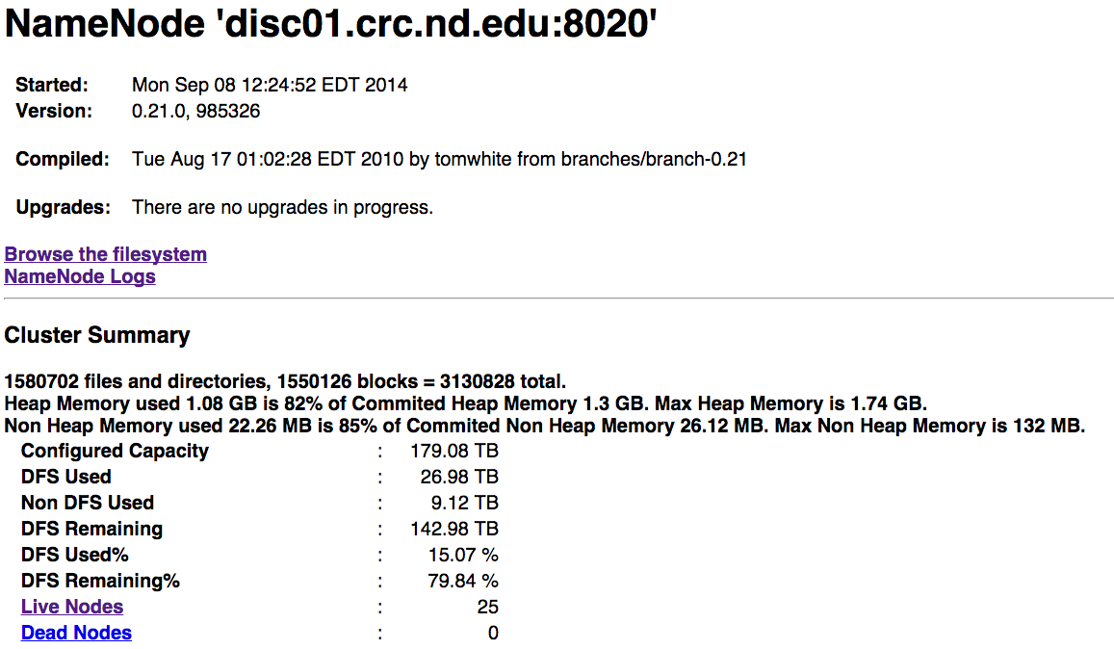
HDFS-Web UI

Slide 54
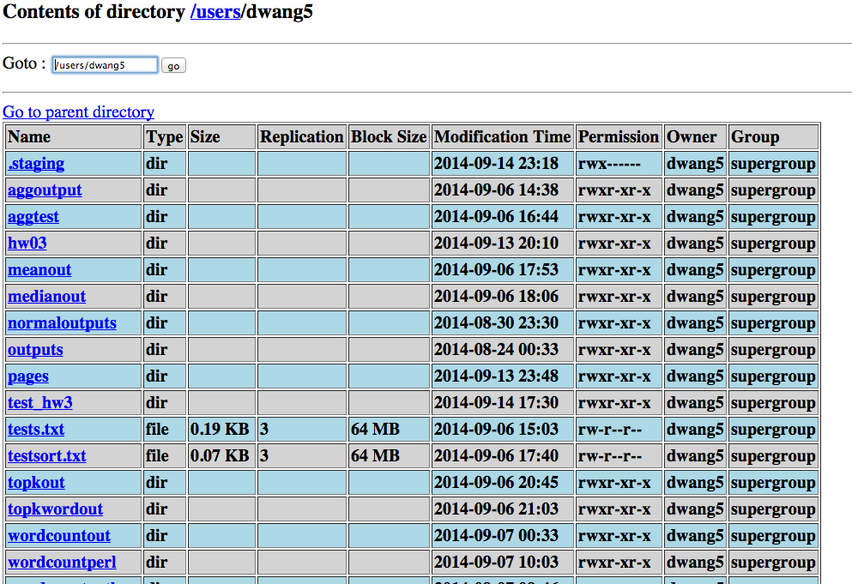
HDFS-Web UI

Slide 55
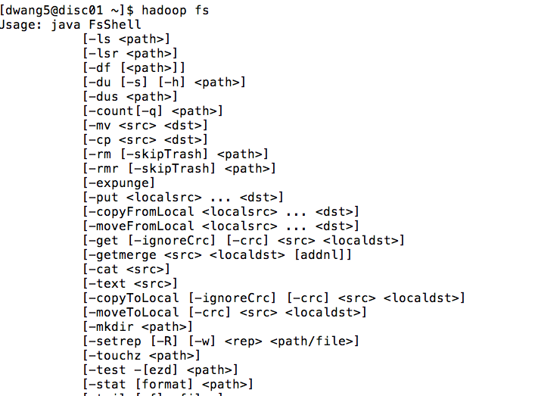
HDFS Command Line
Hadoop Shell

Slide 56
Hadoop Lecture 1 Summary
Big Data and Hadoop background
What and Why about Hadoop
4 V challenge of Big Data
Hadoop Distributed File System (HDFS)
Motivation: guide Hadoop design
Architecture: Single rack vs Multi-rack clusters
Reliable storage, Rack-awareness, Throughput
Inside: Name Node file system, Read, Write
Interface: Web and Command line

